Slide 1

.
DEPARTMENT OF INFORMATION TECHNOLOGY
NOISE POLLUTION MONITORING
Project name : Noise pollution monitoring.
Team name : Proj_22478_Team_4
Team members :
SNEHA.V (113321205049)
DHARSHNI.K(113321205011)
SHARMILA.V(113321205049)
AGNAL CAJOLIN.X.I(113321205003)

Slide 2
PROBLEM DEFINITION
Noise pollution is a growing concern in urban areas, affecting the quality of life and public health.
To address this issue effectively, there is a need for a Noise Pollution Monitoring System (NPMS).
This system aims to monitor, analyze, and manage noise pollution levels in specific areas, providing valuable data for decision-makers and citizens alike.

Slide 3
ABSTRACT
Noise pollution is an unwanted sound,it needs to be controlled to make the workplace comfortable
As we know “Noise Pollution” is one of the most major social issue of our country now a days not only in Pakistan,it the now in all over the world.
In residential areas noise cause because of loud music,transportation,construction,electric generators,explosions etc.
The NPMS comprises a network of strategically placed noise sensors equipped with high-precision microphones. These sensors continuously measure ambient noise levels, collecting data that is transmitted wirelessly to a central server.

Slide 4
OBJECTIVES
Real-Time Monitoring: Implement a system capable of continuously monitoring noise levels in various locations within a designated area, providing up-to-the-minute data.
Data Collection and Storage: Develop a robust data collection and storage mechanism to capture noise data, including decibel levels, timestamps, and location information, and store it securely for future analysis.
Data Analysis: Utilize advanced data analytics to process and interpret noise data, identifying trends, patterns, and noise pollution hotspots.
Alerts and Notifications: Implement a real-time alerting system that issues notifications to relevant authorities and the public when noise levels exceed permissible limits, enabling prompt action.

Slide 5
EXISTING SYSTEM
The existing systems for noise pollution monitoring vary in complexity and coverage, but they generally fall into several categories:
Manual Measurement Stations: In many regions, noise levels are monitored through manual measurement stations.
Permanent Noise Monitoring Stations: Some urban areas have permanent noise monitoring stations equipped with automated noise sensors. These stations provide continuous noise data and can be linked to central databases for real-time monitoring.
Mobile Noise Monitoring: Mobile noise monitoring involves using vehicles equipped with noise sensors to collect data while driving through different parts of a city.
Research Initiatives: Researchers and academic institutions may deploy temporary noise monitoring systems for specific studies or projects.

Slide 6
PROPOSED SYSTEM
A proposed system for noise pollution monitoring would leverage advanced technology to provide accurate, real-time data collection and analysis. Here's an outline of a proposed system:
1. IoT-Based Sensor Network:Deploy a network of IoT-based noise sensors throughout the urban area.These sensors should be strategically located in noise pollution hotspots, near transportation hubs, industrial zones, and residential areas.
2. Data Transmission:Implement a robust data transmission system to relay noise data from sensors to a central server.
3. Centralized Data Processing:The central server should receive, process, and store the incoming noise data.Employ data analytics algorithms to perform real-time noise level analysis.
4. Real-Time Monitoring:Develop a user-friendly web-based or mobile application for real-time monitoring.Provide access to noise level data for authorities, urban planners, and the public.

Slide 7
IOT SENSOR DESIGN
Microphone Sensor: Use a high-quality microphone to capture ambient noise levels.
Microcontroller: Choose a microcontroller (e.g., Arduino, Raspberry Pi) to process the sensor data and control the device.
Connectivity: Incorporate Wi-Fi, Bluetooth, or cellular connectivity to transmit data to a central server or database.
Power Source: Consider a power source, such as a rechargeable battery or solar panel, to ensure continuous operation.
Enclosure: House the components in a weatherproof enclosure to protect them from environmental factors.
Data Processing: Implement algorithms to process and analyze the noise data, including noise level calculations and pattern recognition.
Data Storage: Store the collected data securely, either locally or in the cloud.
User Interface: Develop a user-friendly interface, such as a mobile app or web dashboard, for users to access noise pollution data.

Slide 8
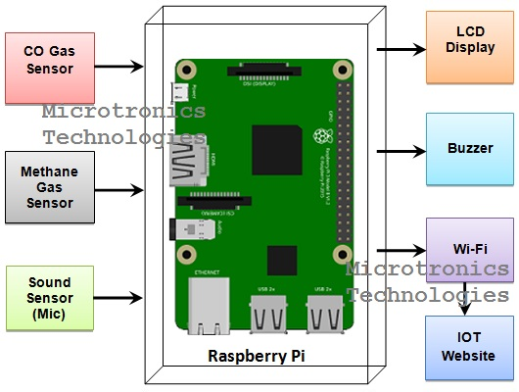
IOT SENSOR DESIGN DIAGRAM

Slide 9
REAL TIME TRANSIT INFORMATION PLATFORM
Platform Integration:Integrate the real-time transit information platform with the existing noise pollution monitoring system to access noise data in real-time.
Data Sources:Combine noise pollution data from monitoring sensors with transit data sources, including GPS tracking of vehicles and transit schedules.
User-Friendly Interface:Develop user interfaces for web and mobile apps that display real-time noise levels at transit stops and along transit routes.Enable users to plan their routes based on noise pollution data, allowing them to choose quieter routes or avoid noisy areas.
Noise Alerts:Implement noise level alerts for users, notifying them when noise pollution exceeds certain thresholds at specific stops or along their chosen routes.
Transit Information:Provide comprehensive transit information, including real-time vehicle locations, arrival times, routes, and schedules.Include features for trip planning, fare information, and accessibility details.

Slide 10
INTEGRATION BENEFITS
Data-Driven Decision Making: Access to real-time and historical noise data enables informed decision-making by local authorities, city planners, and policymakers. They can use this data to enact noise control measures and policies effectively.
Improved Quality of Life: Noise pollution monitoring allows for the identification of noise hotspots and sources, leading to targeted interventions. This, in turn, can enhance the overall quality of life for residents by reducing noise-related stress and sleep disturbances.
Compliance with Regulations: Organizations and industries can use noise monitoring to ensure compliance with noise regulations and standards. This helps in avoiding legal issues and potential fines for noise violations.

Slide 11
.
THANKING YOU

